Slide 1
Threaded Binary Tree (TBT)
22-DEC-2021

Slide 2
Threaded Binary Tree
A threaded binary tree defined as follows:
"A binary tree is threaded by making all right child pointers that would normally be null point to the inorder successor of the node (if it exists), and all left child pointers that would normally be null point to the inorder predecessor of the node."

Slide 3
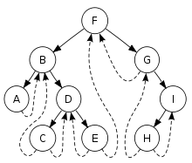
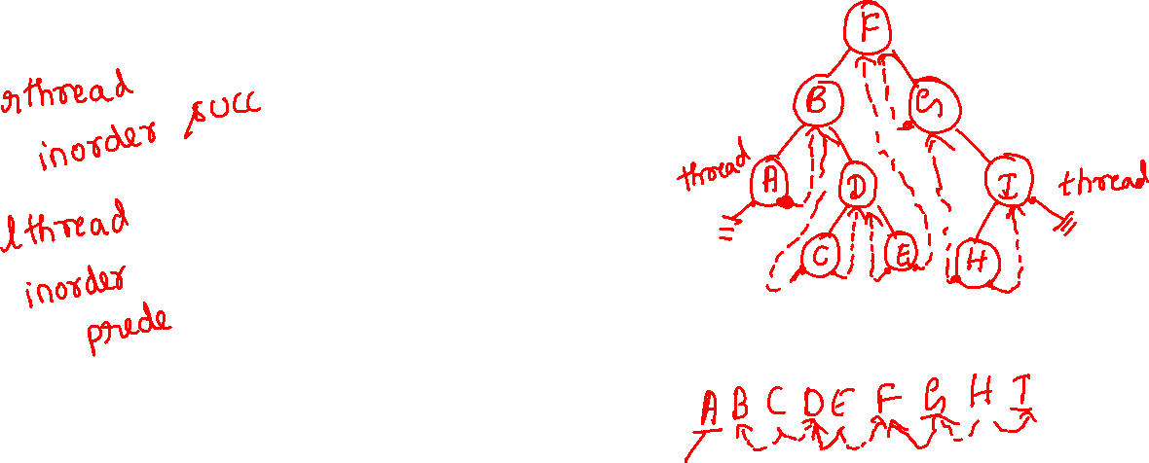
Threaded Tree Example

Slide 4
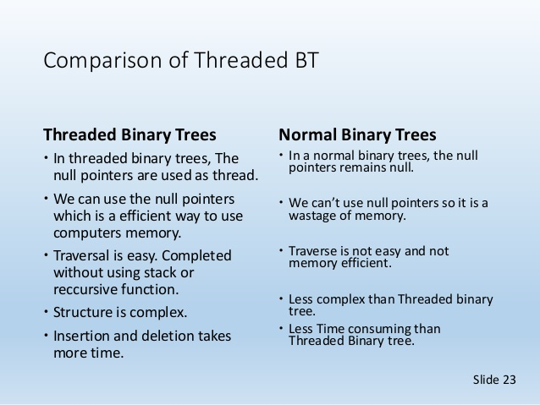

Slide 5
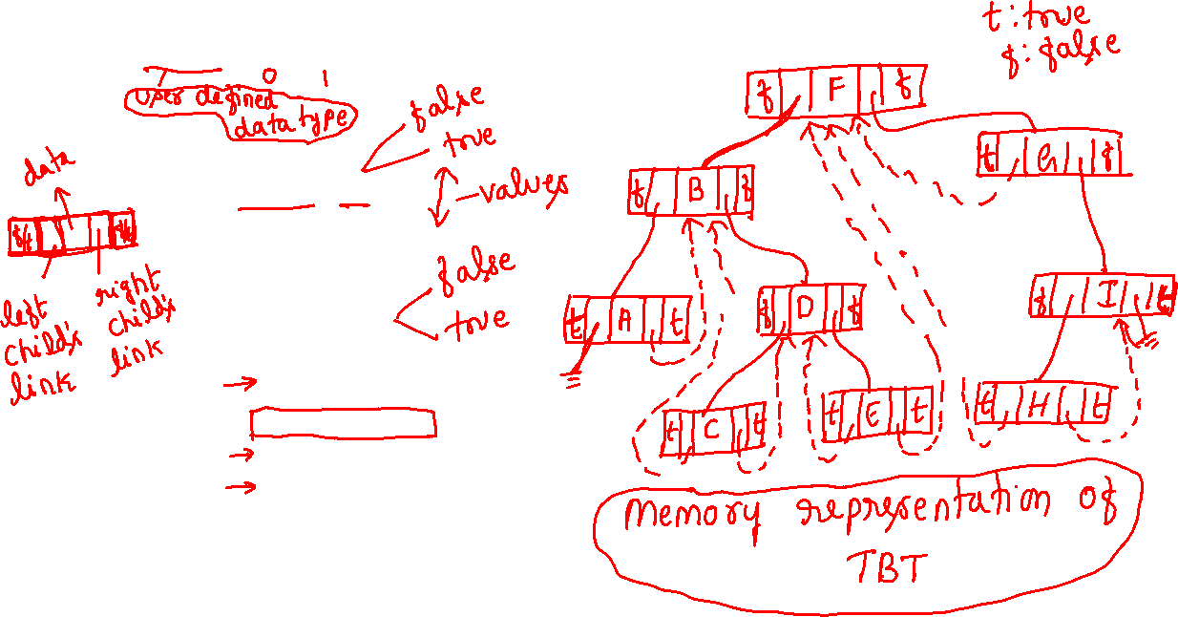
enum boolean{false,true};
class thread
{
enum boolean left;
thread *lchild;
int data;
thread *rchild;
enum boolean right;
public:
//void insert(int num);
void inorder();
//void inorder_new();
//void search(int);
};
thread *head=NULL;

Slide 6
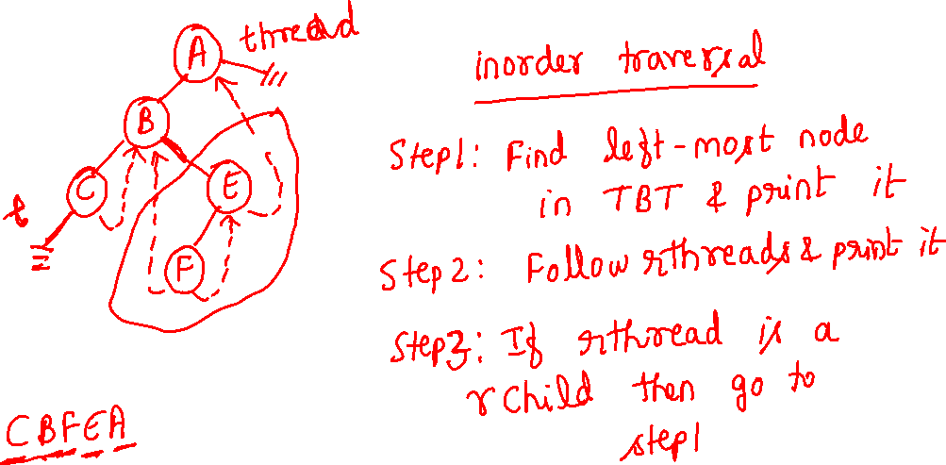

Slide 7

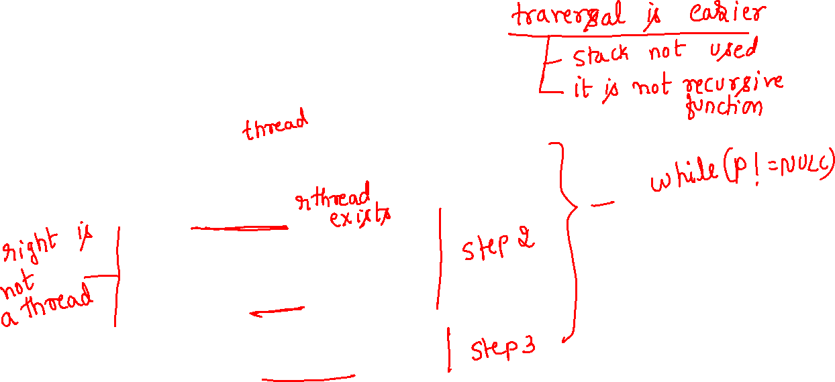
void thread::inorder()
{
thread *p=head;
if(head->rchild==NULL&&head->lchild==NULL)
{ cout<<head->data<<" "; return; }
while(p)
{
while(p->left!=true) p=p->lchild;
cout<<p->data<<" ";
while(p->right==true)
{
p=p->rchild;
if(p==NULL) break;
cout<<p->data<<" ";
}
if(p!=NULL) p=p->rchild;
}
}

